Slide 1
Hibernate Inheritance

Slide 2
Inheritance is an object oriented feature which provides the power of re-usability.
The same concept of re-usability is provided in Hibernate as well.
It is one of the advantages of Hibernate when compared with JDBC.
Assume we have Parent and Child classes, we know that Child class object will have an access to Parent class attributes as well.
In Hibernate when we save Child class object Parent class attributes will also be saved.

Slide 3
Now you may get multiple questions in your mind
1. Whether parent and child class attributes are saved in the same table
2. Whether parent and child class attributes are saved in separate table
3. If they are stored in separate table, how will they be linked
Yes if you have above questions in your mind, Don’t worry you will be getting answers to these questions shortly.

Slide 4
Hibernate provides 3 different ways to represent the inheritance
1.Table per Hierarchy
2.Table per Concrete class
3.Table per Subclass

Slide 5
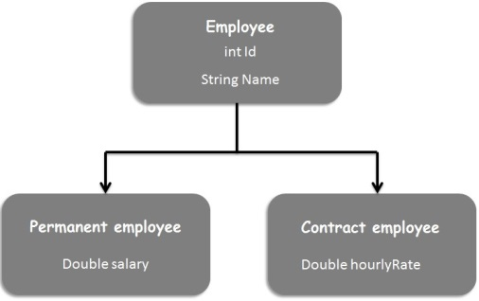

Slide 6
Table per hierarchy
In this approach, as the name suggests the entire hierarchy is mapped to a single table. I.e. All attributes of all the classes are stored in a single table.
A discriminator column is used to distinguish different classes.
Null values will be stored in the table for which there is no column applicable.
Example: We have stored 2 permanent and 1 contract employee details in the below table
Note:
An extra column (also known as discriminator column) is created in the table to identify the class.

Slide 7
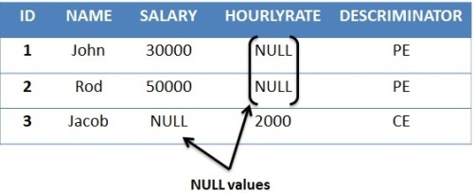
We can see NULL values are stored in Salary column for Contract employee and NULL value is stored in HourlyRate column for Permanent employees.
Note:
Table per hierarchy is not an optimized way of storing relational data as many columns will get NULL values.
In this approach Number of tables equals to one, no matter how many classes are involved.

Slide 8
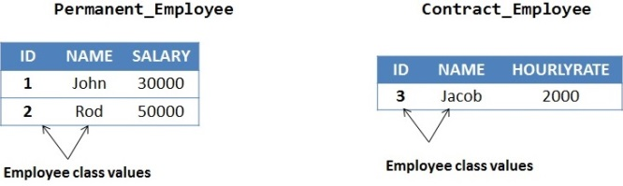
Table per Concrete class
In this case, one table for each concrete class will be created.
All the attributes of parent class will be stored in separate table created for each concrete class.
Example: Assuming Employee class as Abstract,we will get only these 2 tables created for concrete classes.
The main disadvantage of this approach is that parent class attrbiutes are duplicated in each subclass table.
In this approach, Number of tables equals to number of Concrete class.

Slide 9
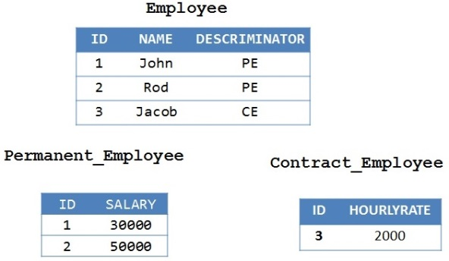
Table per Subclass
In this approach, separate table is required for each class.
Each Subclass table will have only subclass specific columns by having one extra column to have a relationship with the Parent table.
Since there will be a foreign key relationship between the tables,there will not be any duplicate columns.
Example:
As shown above, columns are not duplicated as they are referenced using foreign key in each subclass table.In this approach, Number of tables equals to number of classes.

Slide 10
Inheritance Annotations
By default, Hibernate uses a single table strategy to perform inheritance between the classes. And, there is another way through which Hibernate performs implement inheritance. by using specific annotations with Hibernate.
@Inheritance - This annotation is placed just above the parent Entity class, which tells the Hibernate that this class is the parent of inheritance relationship with other classes.

Slide 11
Hibernate - Sessions
A Session is used to get a physical connection with a database. The Session object is lightweight and designed to be instantiated each time an interaction is needed with the database. Persistent objects are saved and retrieved through a Session object.
The session objects should not be kept open for a long time because they are not usually thread safe and they should be created and destroyed them as needed. The main function of the Session is to offer, create, read, and delete operations for instances of mapped entity classes.

Slide 12
The lifecycle of a Session is bounded by the beginning and end of a logical transaction. The main function of the Session is to offer create, read and delete operations for instances of mapped entity classes. Instances may exist in one of three states:
transient — this instance is not, and never was, attached to a Session; this instance has no corresponding rows in the database; it's usually just a new object that you have created to save to the database
persistent — this instance is associated with a unique Session object; upon flushing the Session to the database, this entity is guaranteed to have a corresponding consistent record in the database
detached — this instance was once attached to a Session (in a persistent state), but now it’s not; an instance enters this state if you evict it from the context, clear or close the Session, or put the instance through serialization/deserialization process.
.

Slide 13
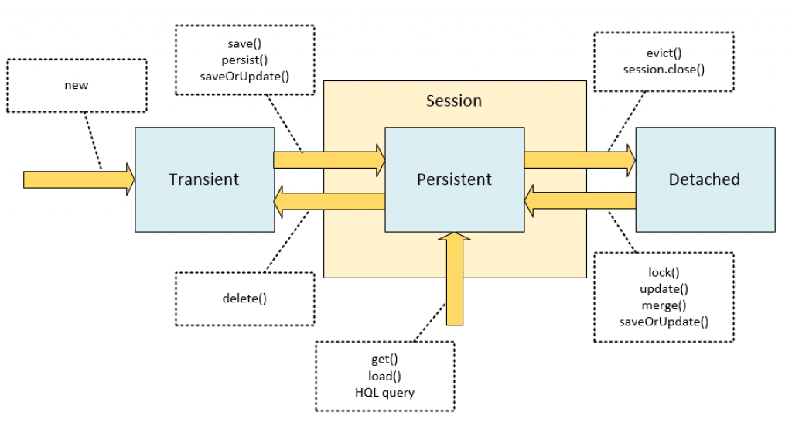
Here is a simplified state diagram with comments on Session methods that make the state transitions happen.

Slide 14
If you want to understand what is transient, you should know what is Serilization concept in Java. Serialization is the process of making the object’s state is persistent. That means the state of the object is converted into stream of bytes and stored in a file. In the same way we can use the de-serilization concept to bring back the object’s state from bytes.
This is one of the important concept in Java programming because this serialization is mostly used in the networking programming. The object’s which are needs to be transmitted through network has to be converted as bytes, for that purpose every class or interface must implement serialization interface. It is a marker interface without any methods.

Slide 15
What is Java Transient?
The keyword transient in Java used to indicate that the variable should not be serialized. By default all the variables in the object is converted to persistent state. In some cases, you may want to avoid persisting some variables because you don’t have the necessity to transfer across the network. So, you can declare those variables as transient. If the variable is declared as transient, then it will not be persisted. It is the main purpose of the transient keyword.

